Slide 1
Breast Cancer Prediction using ML
Data Ingestion
Data Wrangling
Data Visualisation
Train algorithm
Test algorithm
Evaluate the results
Abraham Tony

Slide 2
Introduction
Breast cancer (BC) is one of the most common cancers among women worldwide,
representing the majority of new cancer cases and cancer-related deaths according
to global statistics, making it a significant public health problem in today’s society.
The early diagnosis of BC can improve the prognosis and chance of survival
significantly, as it can promote timely clinical treatment to patients. Further accurate
classification of benign tumors can prevent patients undergoing unnecessary
treatments. Thus, the correct diagnosis of BC and classification of patients into
malignant or benign groups is the subject of much research. Because of its unique
advantages in critical features detection from complex BC datasets, machine
learning (ML) is widely recognized as the methodology of choice in BC pattern
classification and forecast modelling.

Slide 3
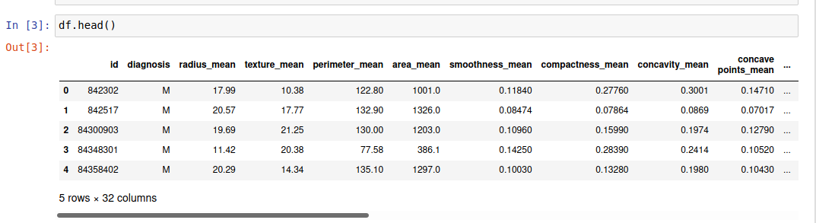
Data Ingestion
Source: http://archive.ics.uci.edu/ml/datasets/breast+cancer+wisconsin+%28diagnostic%29

Slide 4
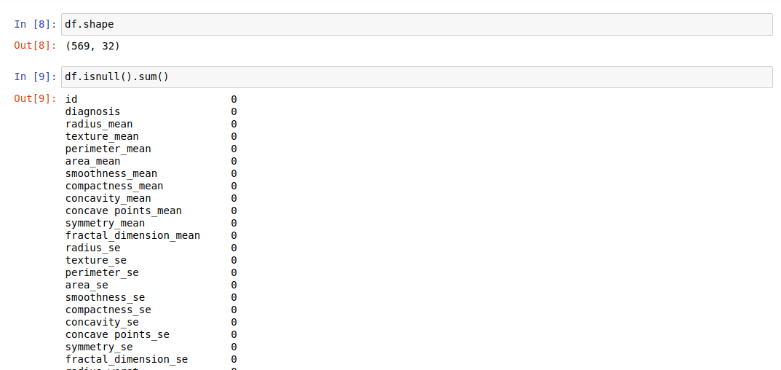
Data wrangling
Structuring,cleaning and validating data set.

Slide 5
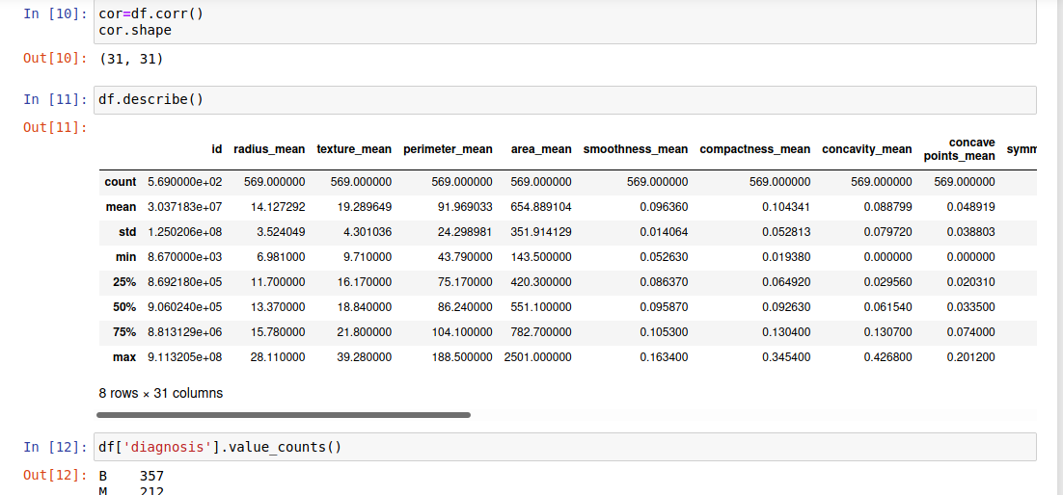
Get a count of the number of patients with Malignant (M) cancerous and Benign (B) non-cancerous cells.
Explore the data and count the number of rows and columns in the data set. Their are 569 rows of data which means their are 569 patients in this data set, and 33 columns which mean their are 33 features or data points for each patient.

Slide 6
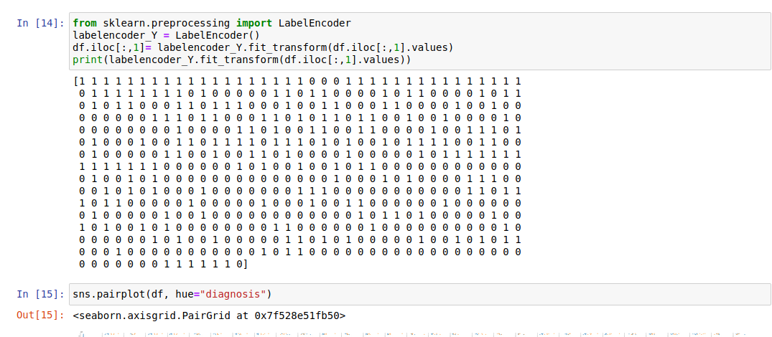
Encode the categorical data. Change the values in the column ‘diagnosis’ from M and B to 1 and 0 respectively, then print the results.

Slide 7
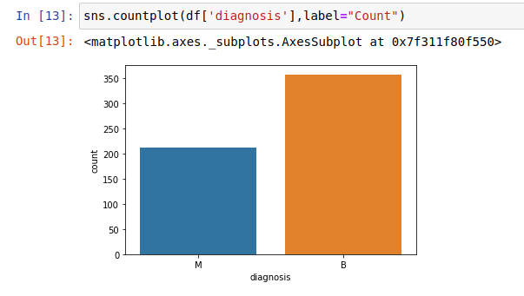
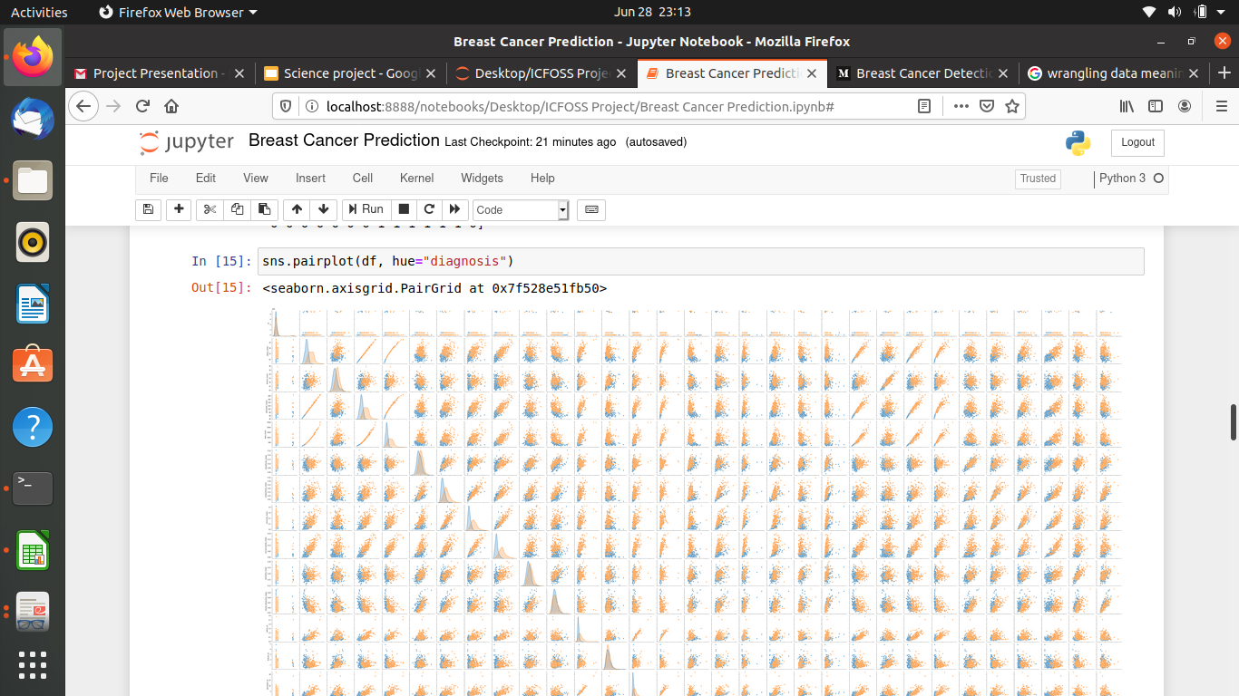
Data Visualisation

Slide 8
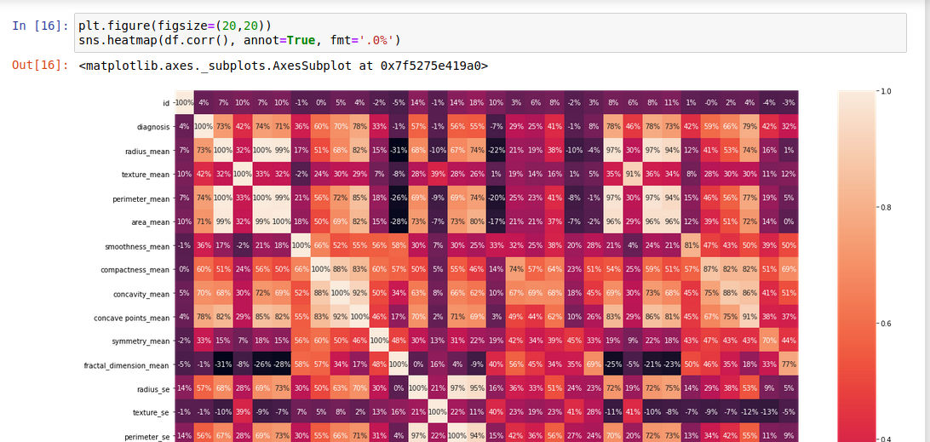
Visualize the counts, by creating a count plot.

Slide 9
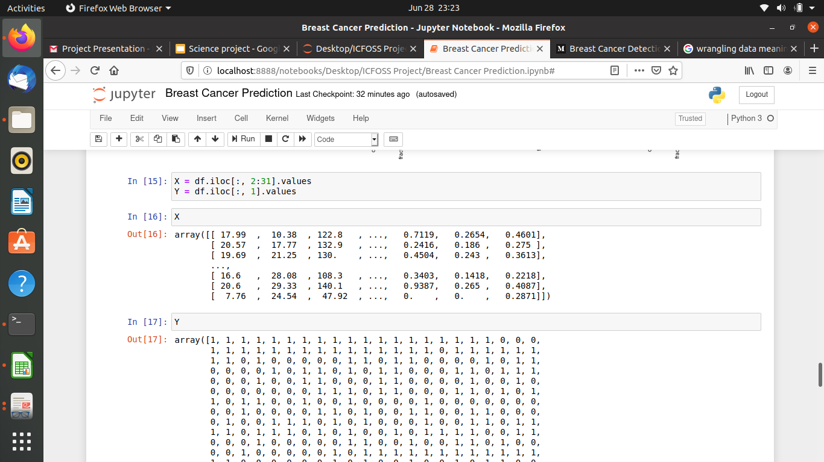
Data Splitting
Now I am done exploring and cleaning the data. I will set up my data for the model by first splitting the data set into a feature data set also known as the independent data set (X), and a target data set also known as the dependent data set (Y).

Slide 10
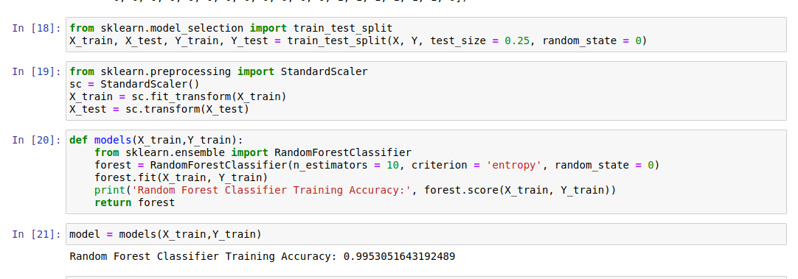
Training and testing the data

Slide 11
Show the confusion matrix and the accuracy of the models on the test data. The confusion matrix tells us how many patients each model misdiagnosed (number of patients with cancer that were misdiagnosed as not having cancer a.k.a false negative, and the number of patients who did not have cancer that were misdiagnosed with having cancer a.k.a false positive) and the number of correct diagnosis, the true positives and true negatives.

Slide 12
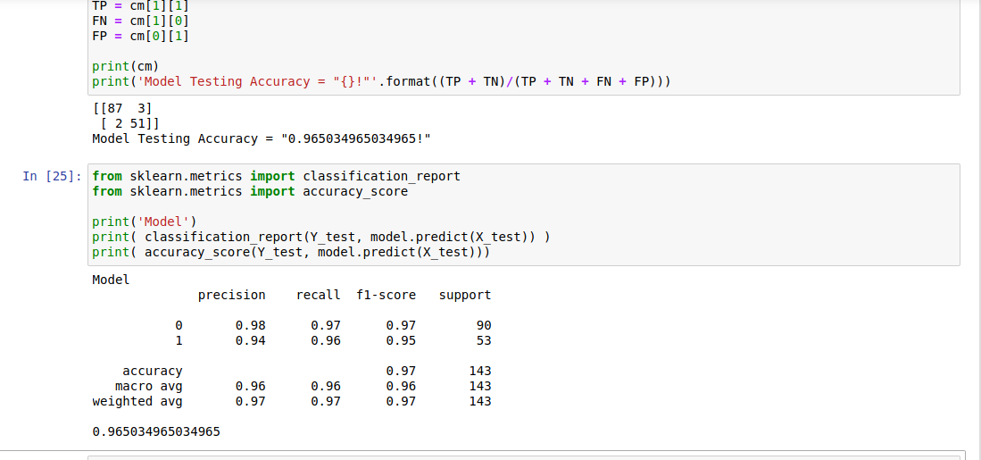
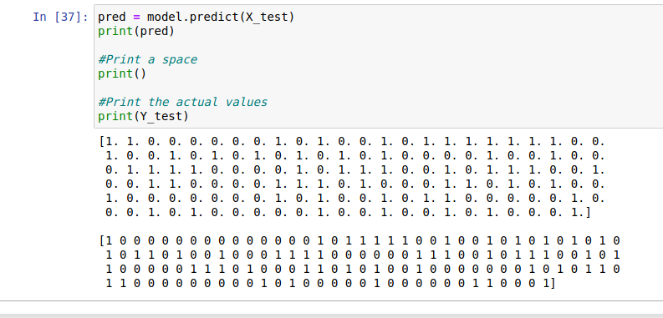
The Result

Slide 13
Conclusion
This is a basic Machine Learning model to predict Breast Cancer and classifying as benign or malignant. Random Forest Classification algorithm gives the best results for our dataset. Well it's not always applicable to every dataset. To choose our model we always need to analyze our dataset and then apply our machine learning model.

